Slide 1
Deploy and Manage your Microservices with Istio
Presented by: Muhammad Irfan

Slide 2
What is Istio?
Istio is an open source project designed to reduce complexity of deploying, managing, and monitoring microservices in service mesh
It is also a platform, including APIs that let it integrate into any logging platform, or telemetry or policy system.
Istio’s diverse feature set lets you successfully, and efficiently, run a distributed microservice architecture, and provides a uniform way to secure, connect, and monitor microservices.

Slide 3
…What is Istio?
Istio makes it easy to create a network of deployed services with load balancing, service-to-service authentication, monitoring, and more, without any changes in service code.
You add Istio support to services by deploying a special sidecar proxy throughout your environment that intercepts all network communication between microservices, then configure and manage Istio using its control plane functionality.

Slide 4
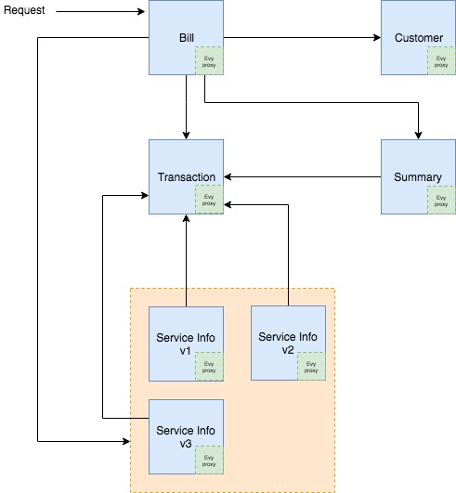
What is Service Mesh?
Service Mesh is the network of microservices that make an applications

Slide 5
Core Features
Traffic management
Security
Observability
Platform support
Integration and customization

Slide 6
Architecture
Two main parts of Istio data plane and a control plane.
Data Plane
The data plane is composed of a set of intelligent proxies (Envoy) deployed as sidecars. These proxies mediate and control all network communication between microservices along with Mixer, a general-purpose policy and telemetry hub.
Control Plan
The control plane manages and configures the proxies to route traffic. Additionally, the control plane configures Mixers to enforce policies and collect telemetry.

Slide 7
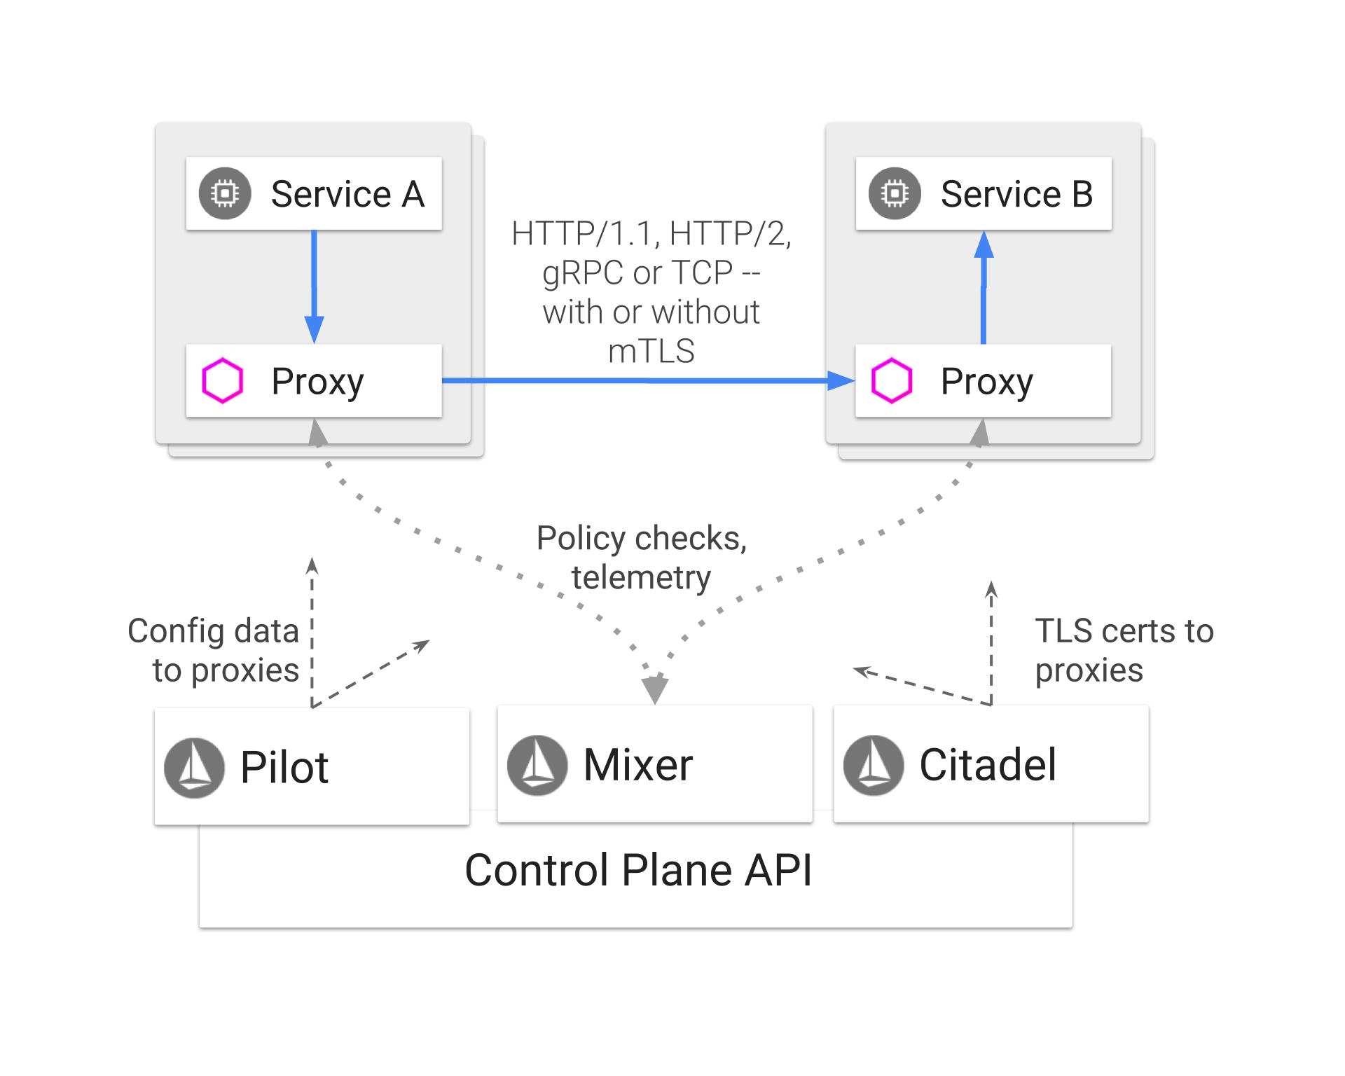
... Architecture

Slide 8
Envoy
Istio uses Envoy side car proxy to mediate all inbound and outbound traffic for all services in the service mesh.
Envoy provides following features:
Dynamic service discovery
Load balancing
TLS termination
HTTP/2 and gRPC proxies
Circuit breakers
Health checks
Staged rollouts with %-based traffic split
Fault injection
Rich metrics
Istio adds Envoy side car proxy into Kubernetes pod to provide Istio capabilities

Slide 9
Mixer
Mixer is a platform-independent component. Mixer enforces access control and usage policies across the service mesh, and collects telemetry data from the Envoy proxy and other services. The proxy extracts request level attributes, and sends them to Mixer for evaluation.
Mixer includes a flexible plugin model. This model enables Istio to interface with a variety of host environments and infrastructure backends. Thus, Istio abstracts the Envoy proxy and Istio-managed services from these details.

Slide 10
Pilot
Pilot provides service discovery for the Envoy sidecars, traffic management capabilities for intelligent routing (e.g., A/B tests, canary deployments, etc.), and resiliency (timeouts, retries, circuit breakers, etc.).
Pilot converts high level routing rules that control traffic behaviour into Envoy-specific configurations, and propagates them to the sidecars at runtime.
Pilot abstracts platform-specific service discovery mechanisms and synthesizes them into a standard format that any sidecar conforming with the Envoy data plane APIs can consume.

Slide 11
Citadel
Citadel provides strong service-to-service and end-user authentication with built-in identity and credential management.
Operators can enforce policies based on service identity rather than on network controls.
Use Istio’s authorization feature to control who can access your services.

Slide 12
Galley
Galley validates user authored Istio API configuration on behalf of the other Istio control plane components.

Slide 13
Traffic Management

Slide 14
Traffic Management
Request routing
Ingress and egress
Discovery and load balancing
Handling failures
Fault injection
Timeouts and retries

Slide 15
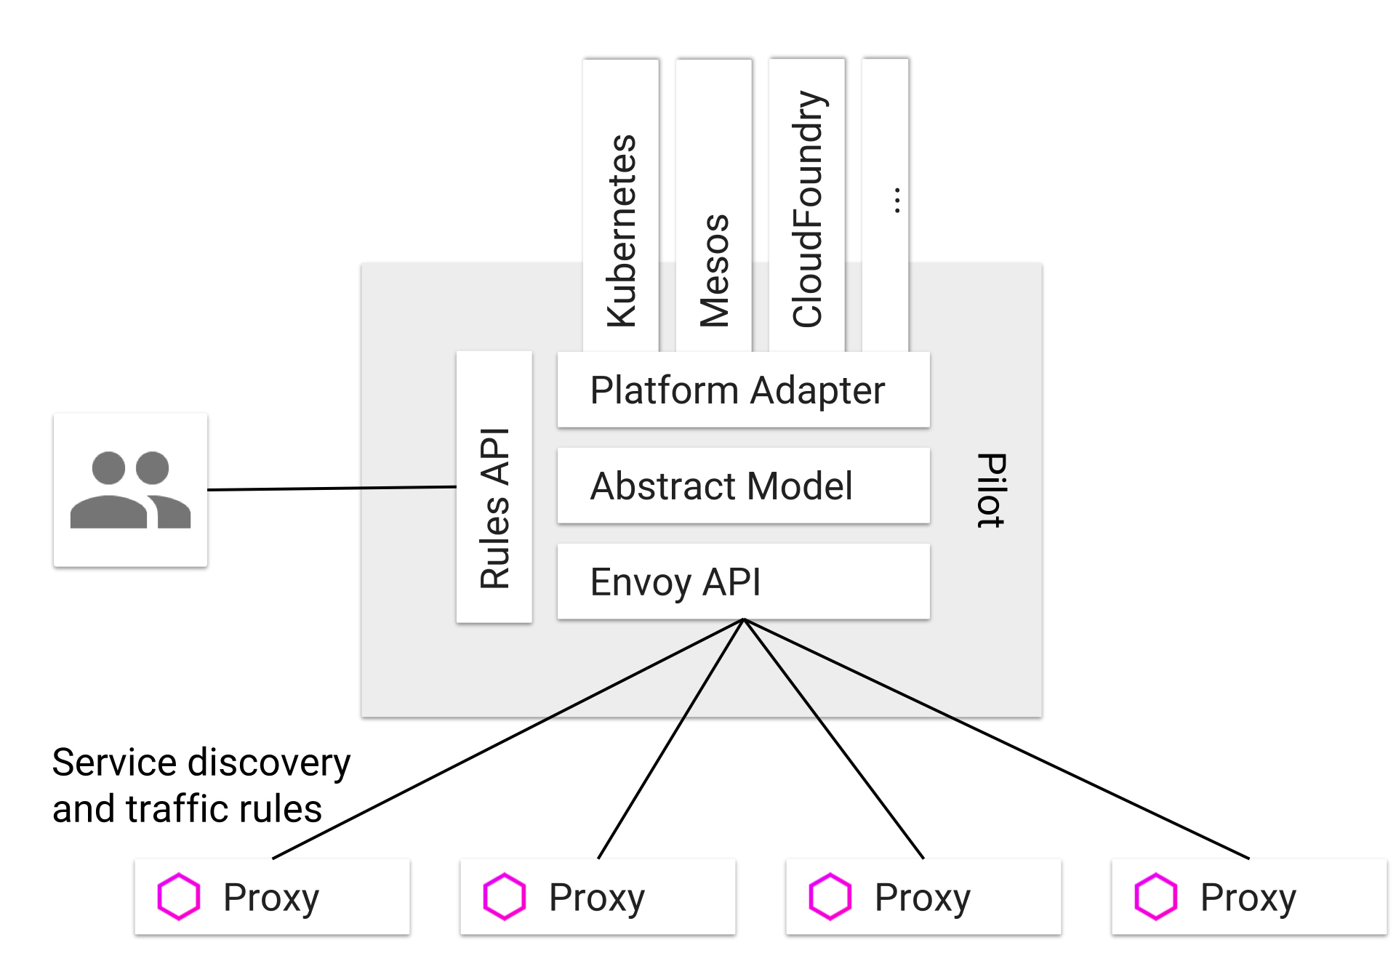
Pilot and Envoy
Pilot manage and configure all the Envoy proxy instances deployed in a particular Istio service mesh
Pilot is responsible for the lifecycle of Envoy instances deployed across the Istio service mesh

Slide 16
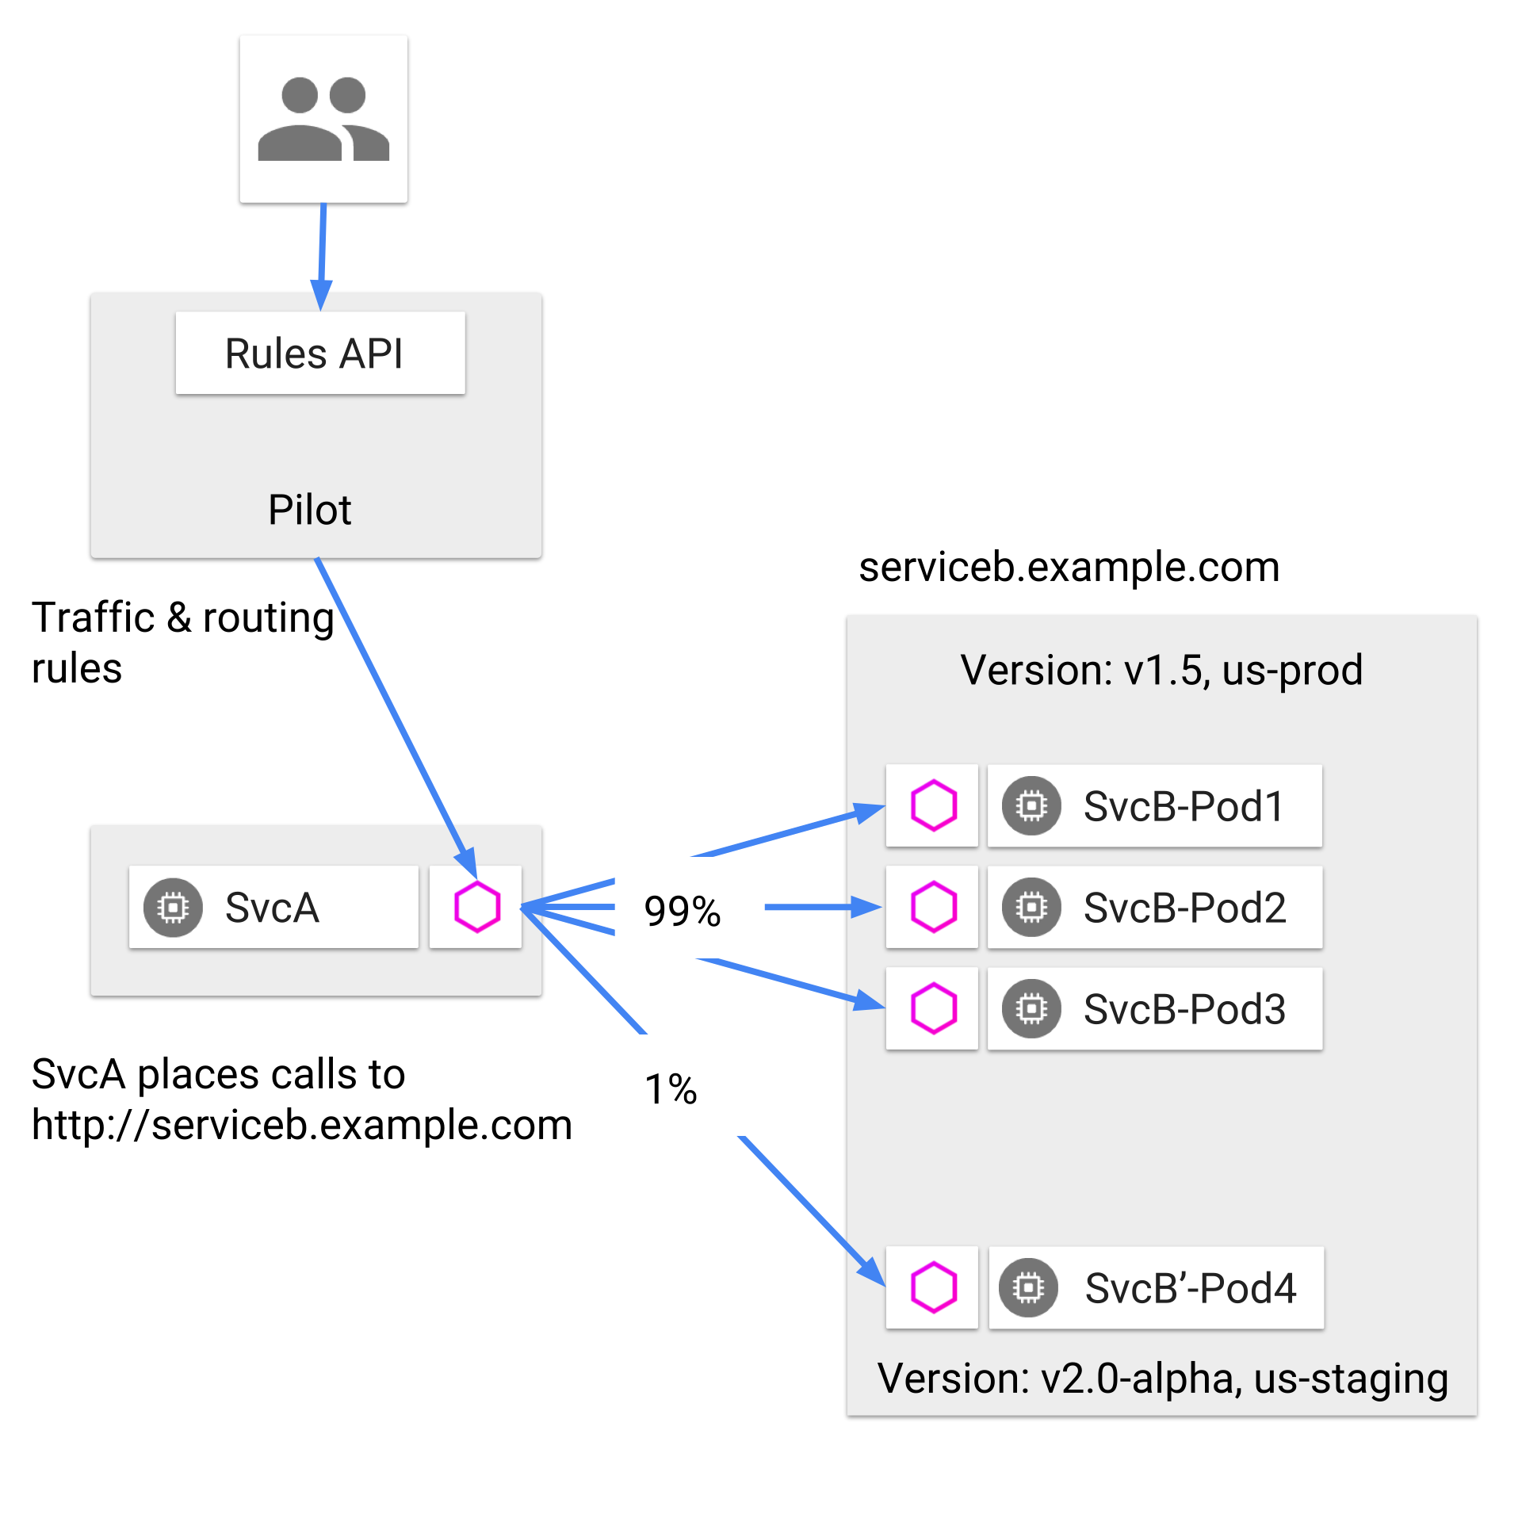
Request Routing

Slide 17
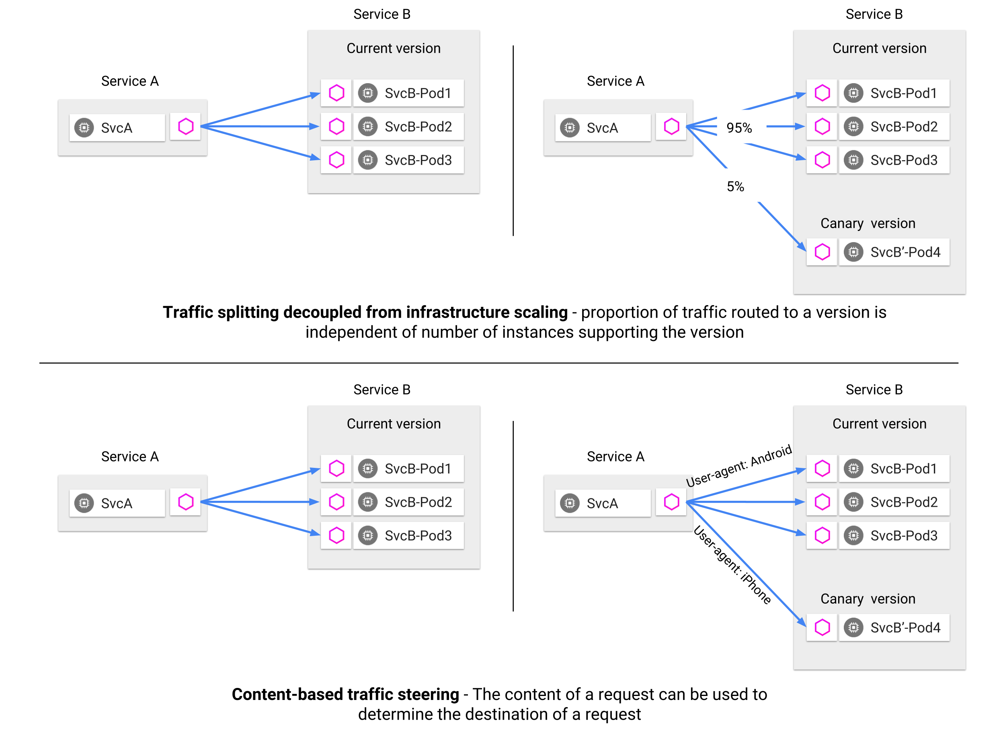
… Request Routing

Slide 18
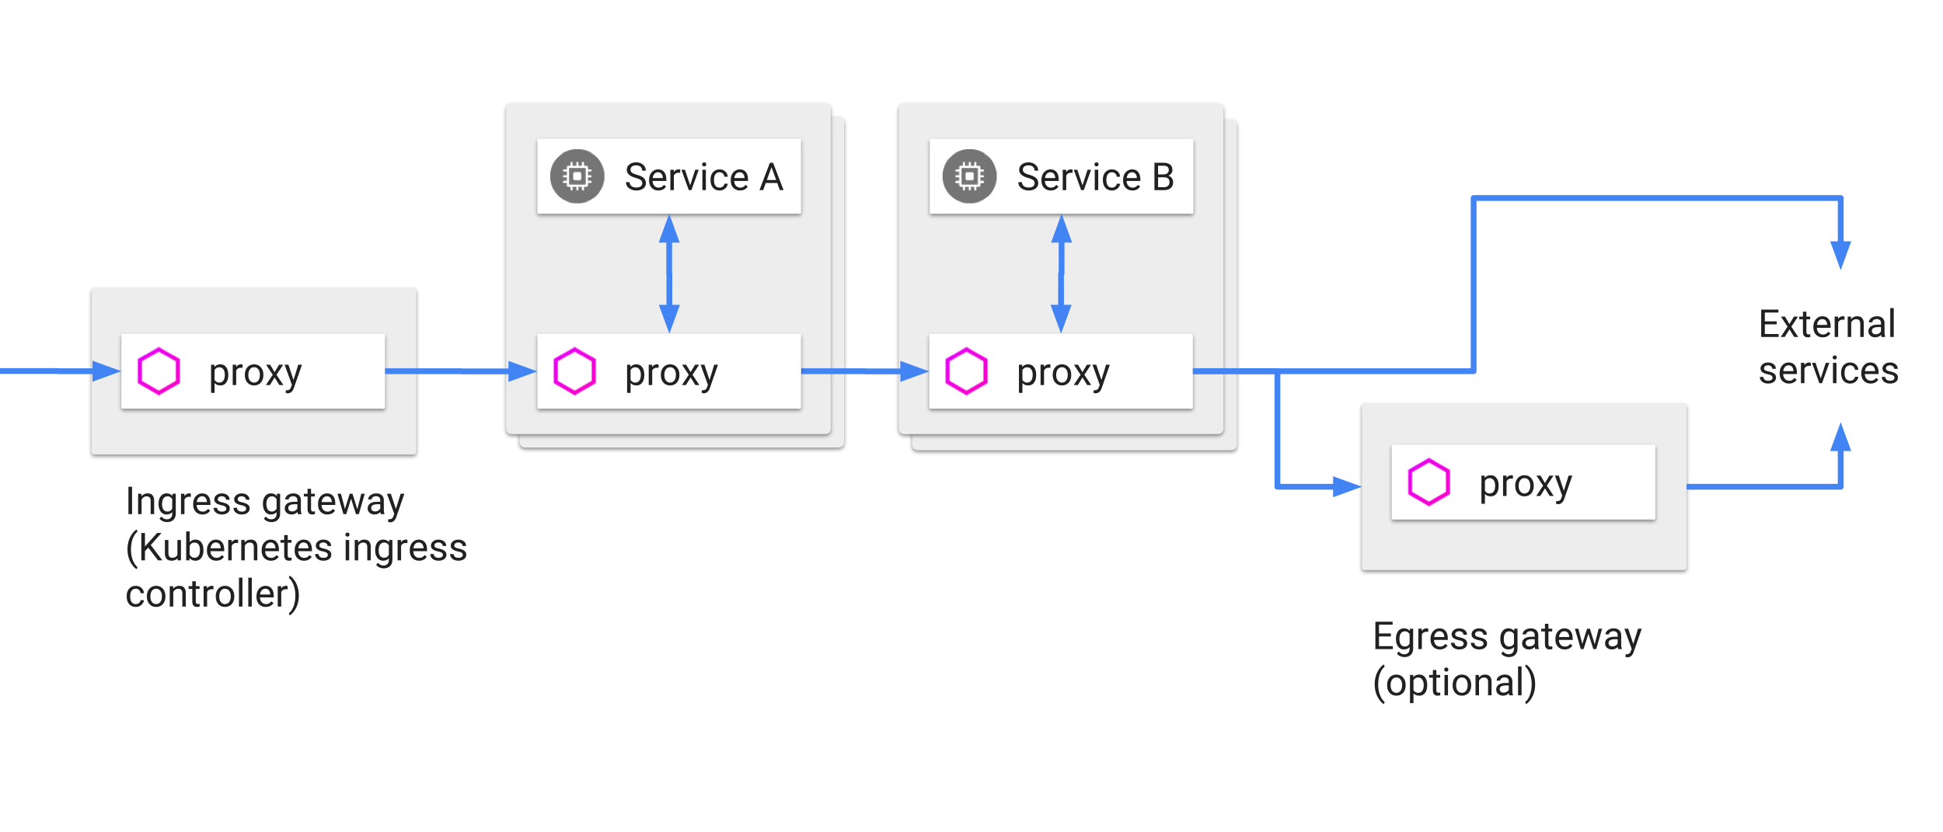
Ingress and Egress

Slide 19
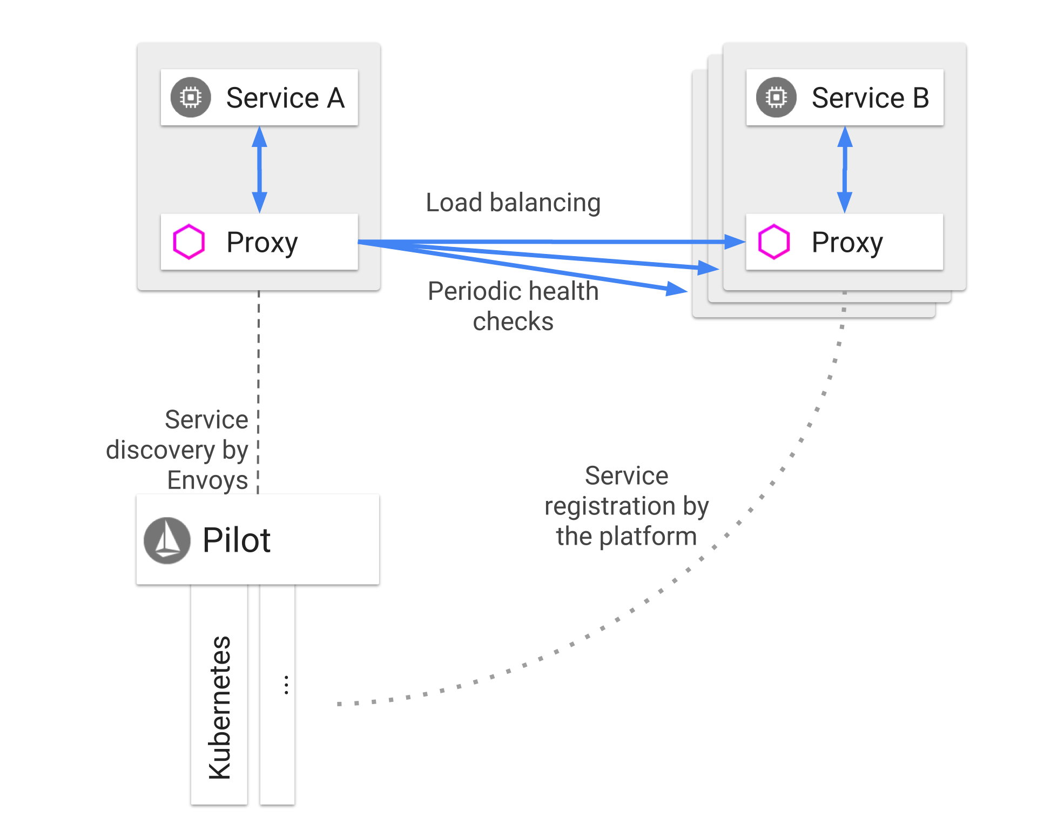
Discovery and Load Balancing

Slide 20
Security

Slide 21
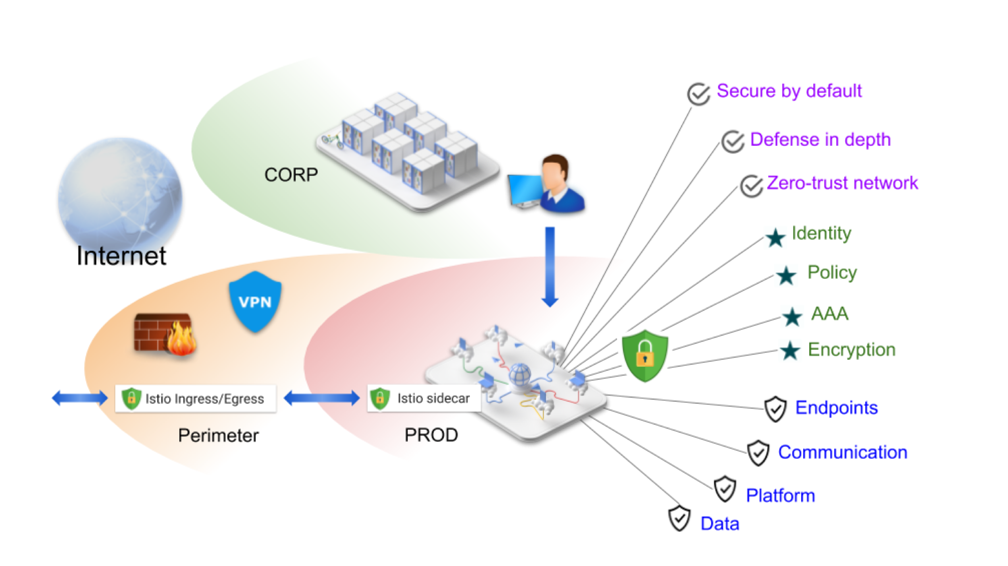
Overview

Slide 22
Security Architecture
Security in Istio involves multiple components:
Citadel for key and certificate management
Sidecar and perimeter proxies to implement secure communication between clients and servers
Pilot to distribute authentication policies and secure naming information to the proxies
Mixer to manage authorization and auditing

Slide 23
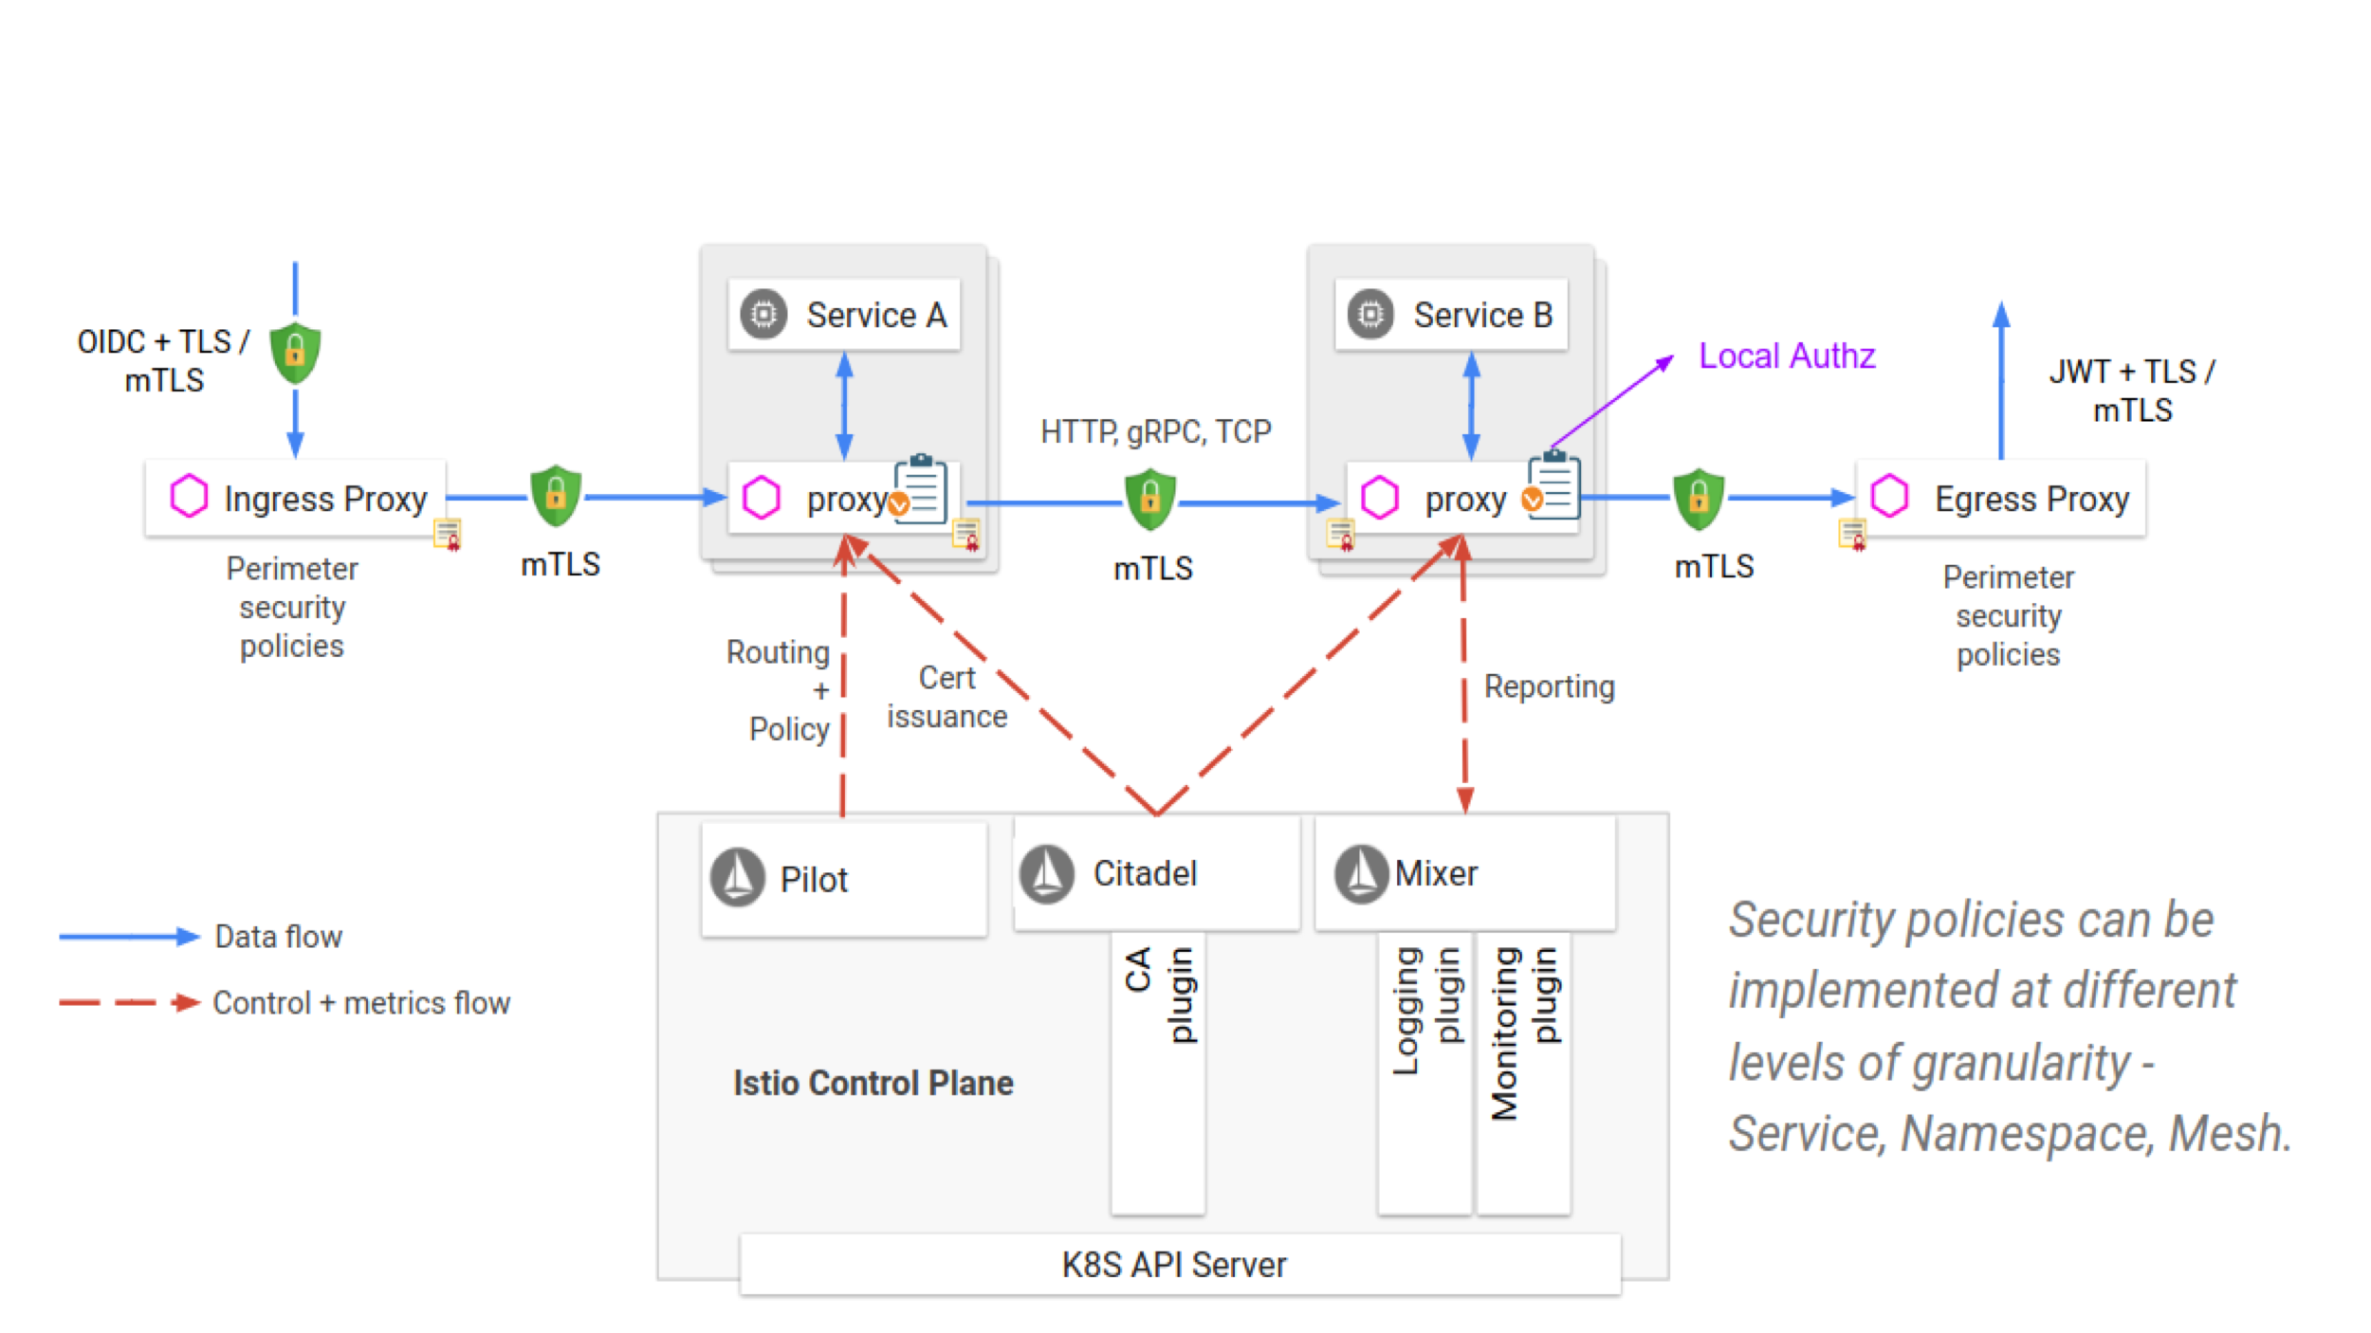
Security Architecture

Slide 24
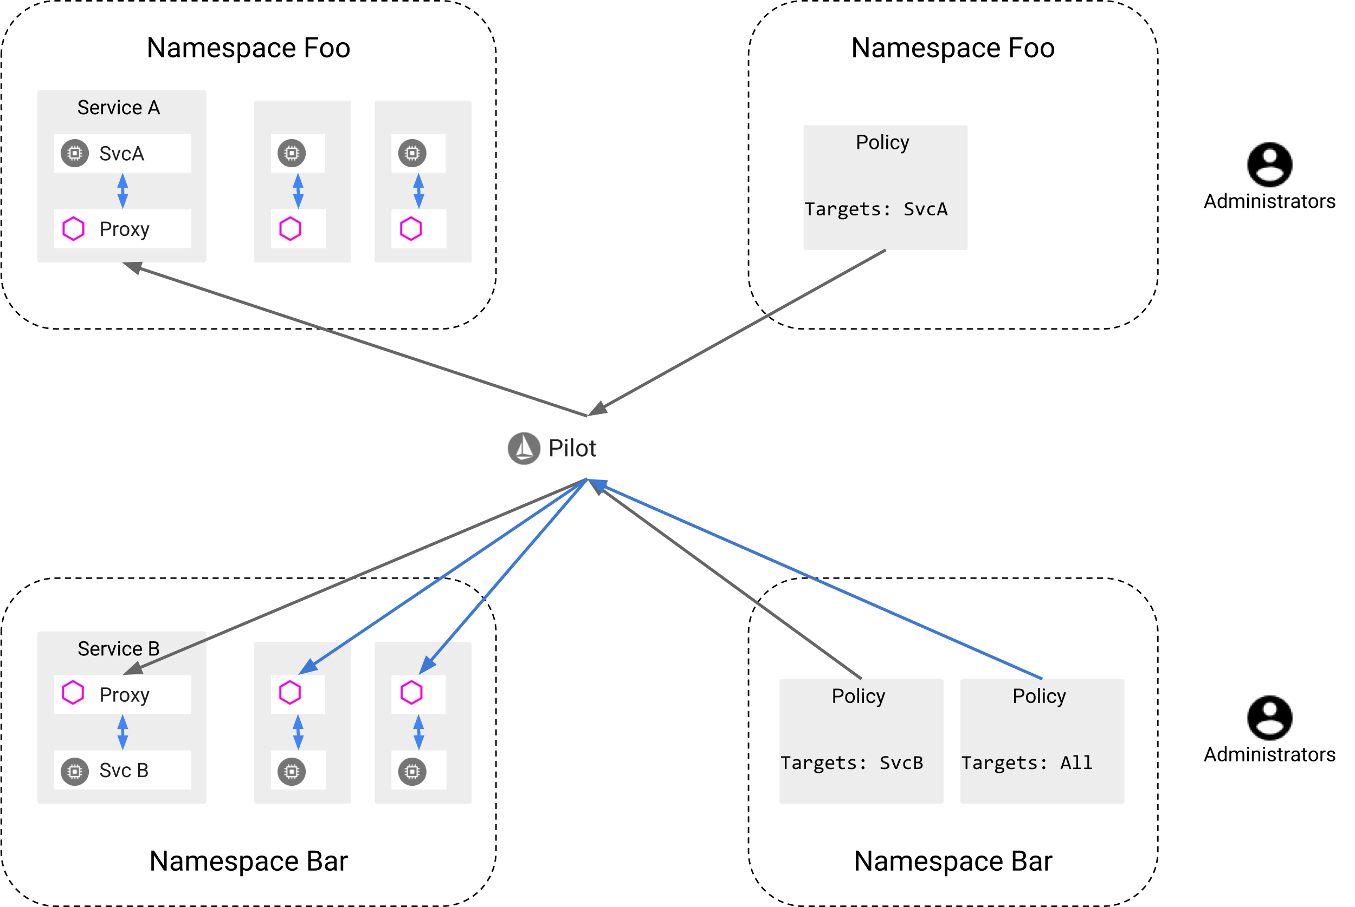
Authentication Architecture

Slide 25
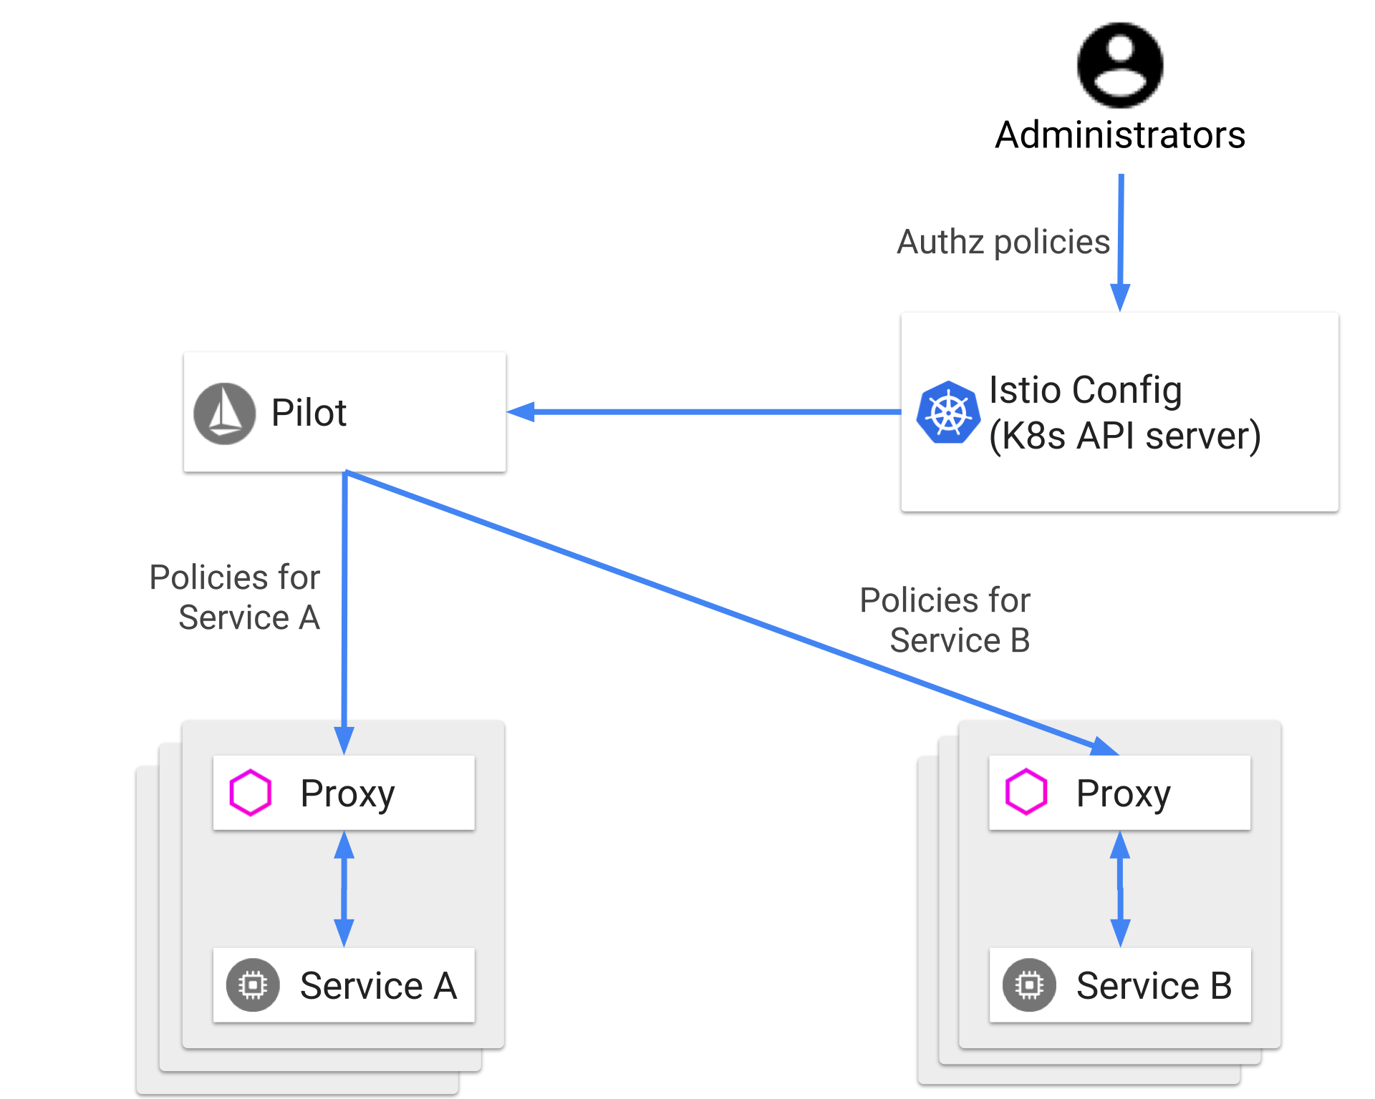
Authorization Architecture

Slide 26
Policies and Telemetry

Slide 27
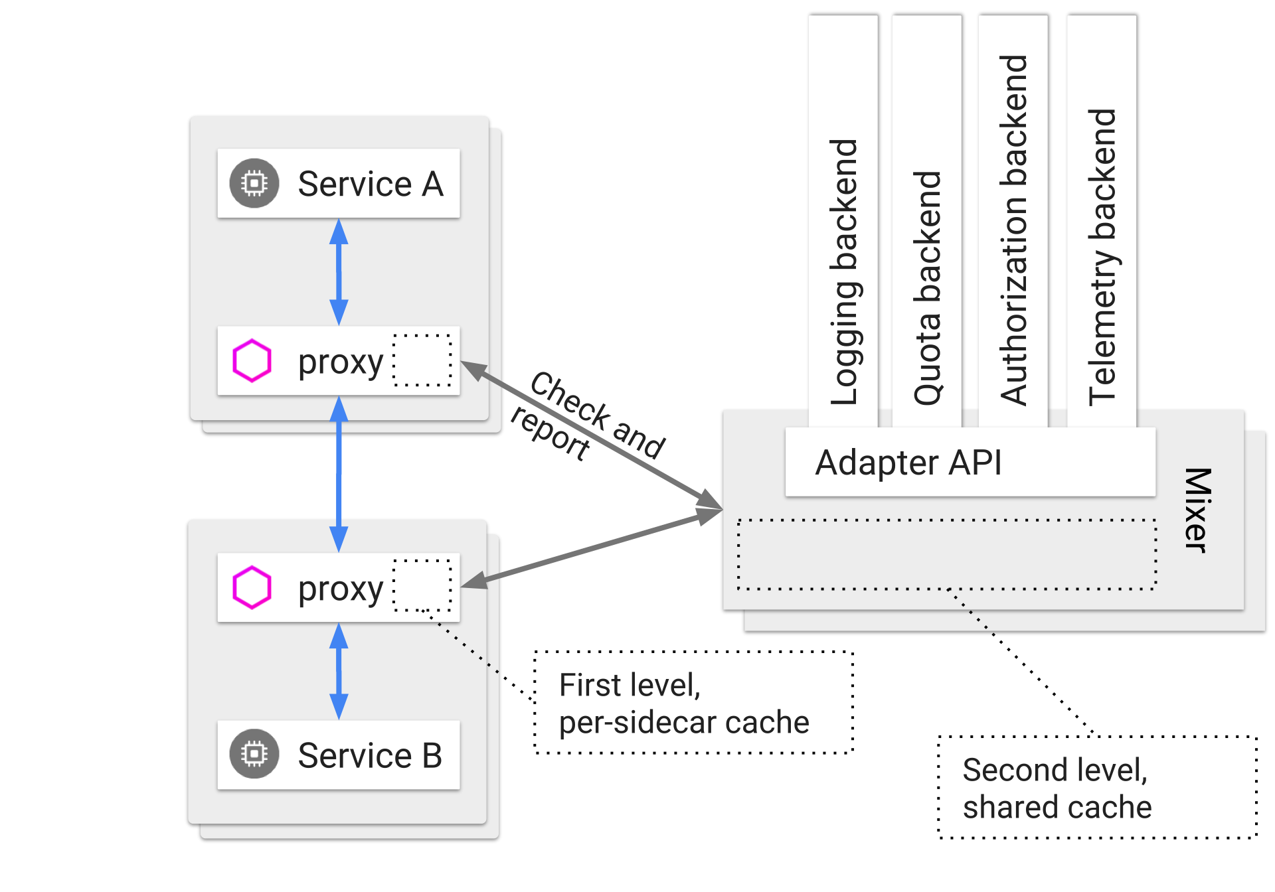
Mixer Topology

Slide 28
Monitoring Tools
Jaeger
Prometheus
Grafana
Service Graph
forcegraph
Dotviz - is a static Graphviz visualization
Dotgraph - rovides a DOT serialization
D3graph - provides a JSON serialization for D3 visualization
graph - provides a generic JSON serialization
Weave Scope
Logging with Fluentd

Slide 29
Cloud Foundry Future
Cloud Foundry runs on Kubernetes instead of BOSH
Cloud Foundry inject the Envoy side car proxy to the app pod (previously app container on cf push)
Istio mTLS support between pods
Cloud Foundry will manage and rotate mTLS certs
North-South and Eash-West traffic
Istio weighted routing feature through manifest file directly. This will ease blue-green and avoid managing the app instances to increase or decrease traffic.
Istio and Envoy will replace existing routing components Gorouter, NATS, TCP Router, and the Routing API.
Envoy side car proxy will take over the client side load balancing
Istio based application security policies
https://github.com/cloudfoundry/istio-release

